Slide 1
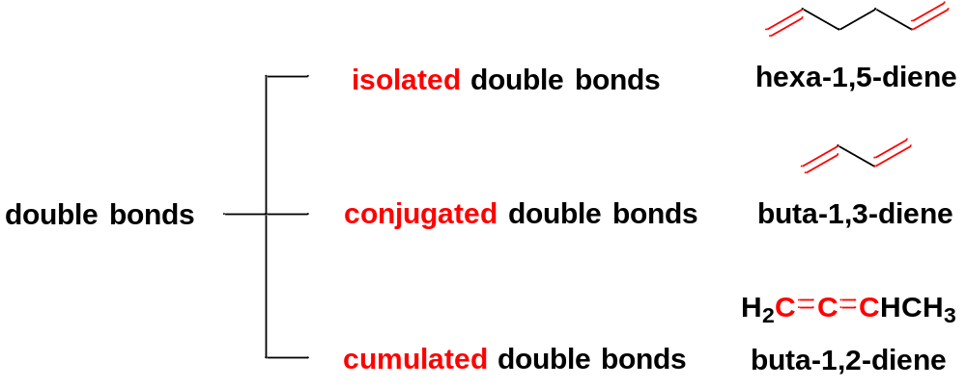
Chapter 5 Conjugated Dienes and the Resonance Theory
5-1 Classification of double bonds
Isolated double bonds are separated by two or more single bonds.
Conjugated double bonds are separated by one single bond.
Cumulated double bonds are on adjacent carbons.
Conjugated double bonds can interact with each, resulting in unique properties.

Slide 2
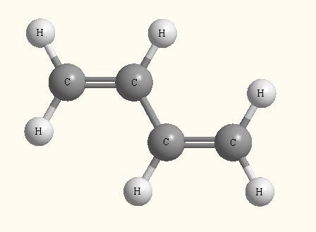
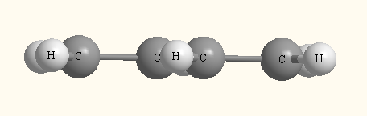
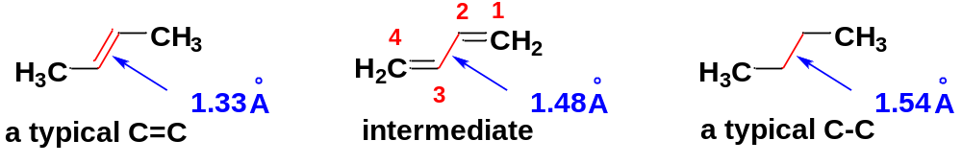
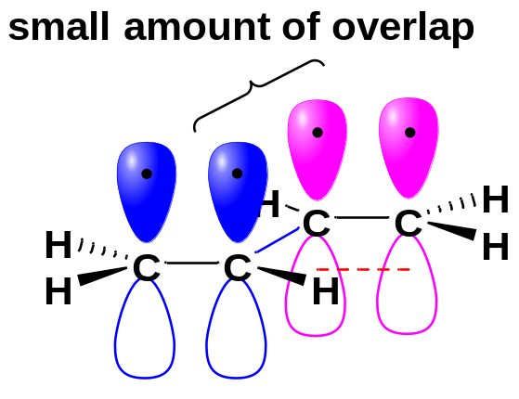
5-2 Structure and Bonding of Buta-1,3-diene
The Structure of buta-1,3-diene in its most stable conformation is planar.
The C2-C3 bond length is intermediate between the normal length of a single bond and that of a double bond.
The planar conformation, with the p orbitals of the two double bonds aligned, allows overlap between the pi bonds.
The electrons in the double bonds are not localized in each double bond, but are delocalized over the entire molecule, creating some pi overlap and pi bonding in the C2-C3 bond.

Slide 3

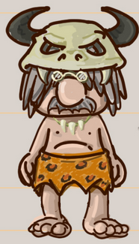
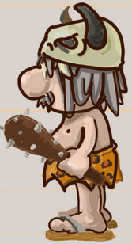
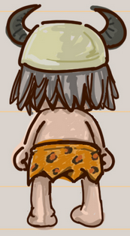
5-3 Resonance theory
The structures of some molecules and ions are not adequately represented by a single Lewis structure. In such cases, we use more than one Lewis structures to mutually represent them.
front view
side view
back view
These Lewis structures differ only in the placement of electrons and individual Lewis structures show a characteristic of the compounds they mutually represent.
The different Lewis structures are called resonance forms because they are not different compounds, just different ways of drawing the same compound.
The actual molecule is said to be a resonance hybrid of its resonance forms.
We use a single double-headed arrow between resonance forms to indicate that the actual structure is a hybrid of the Lewis structures we have drawn. Resonance forms are enclosed in brackets.

Slide 4
The General Rules of Drawing Resonance Forms
(1) All the resonance forms must be valid Lewis structures.
(2) Only the placement of the electrons (electrons in double bonds and lone pairs) may be shifted from one structure to another. Nuclei cannot be moved, and the bond angles must remain the same.
(3) The number of unpaired electrons (if any) must remain the same. Most stable compounds have no unpaired electrons, and all the electrons must remain paired in all the resonance forms.
(4) The major resonance contributor is the one with the lowest energy. Good contributors generally have all octets satisfied, as many bonds as possible, and as little charge separation as possible. Negative charges are more stable on more electronegative atoms, such as O, N, and S.
(5) More stable resonance forms are closer representations of the real molecule than less stable ones.

Slide 5
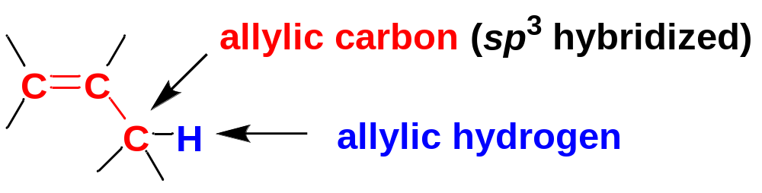
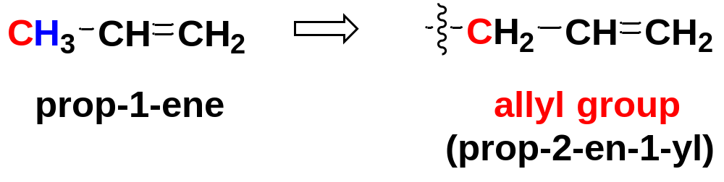
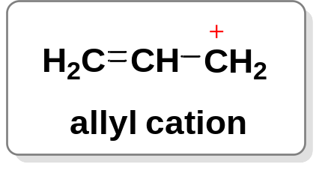
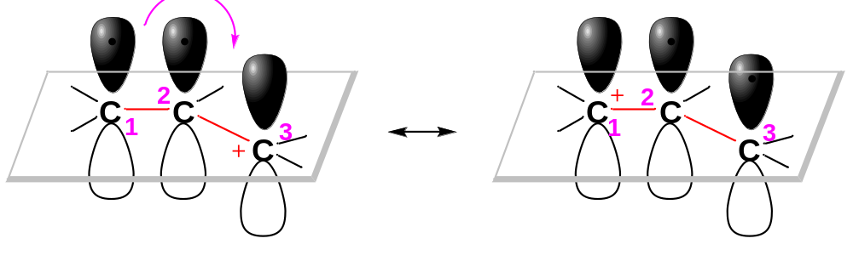
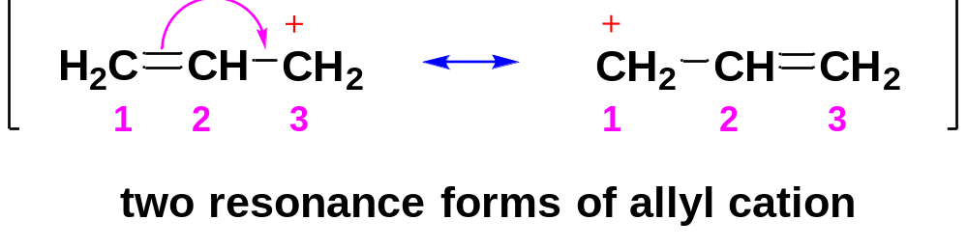
5-4 Allylic Cations
Conjugated dienes undergo many reactions which involve allylic cations and allylic radicals.
Carbon adjacent to C=C double bond is allylic.
5-4-1 Allyl cation
Allyl cation is an allyl group with a positive charge on the allylic carbon.
In fact, the positive charge in the allyl cation is not localized over one carbon, but delocalized over two carbons.
One Lewis structure is not adequate to represent the real structure of the allyl cation. We represent the delocalized allyl cation by resonance forms.

Slide 6
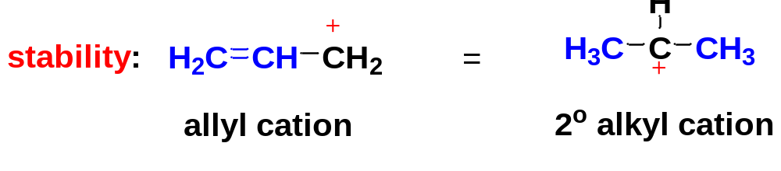
Allyl cation is stabilized by resonance with the adjacent double bond, which delocalizes the positive charge over two carbon atoms.
Resonance is most important to stabilization when it serves to delocalize a charge over two or more atoms.
Because of its resonance stabilization, the allyl cation (1°) is about as stable as simple 2° alkyl carbocations.
positive charge stabilized by hyperconjugation with the adjacent alkyl groups
positive charge stabilized by resonance with the adjacent C=C

Slide 7
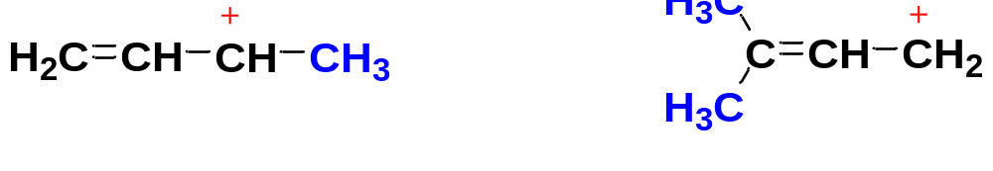
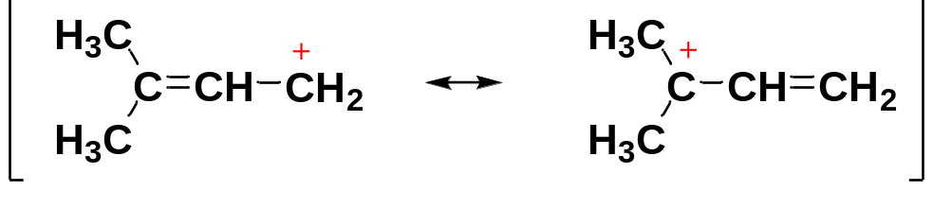
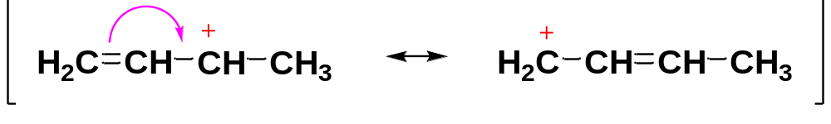
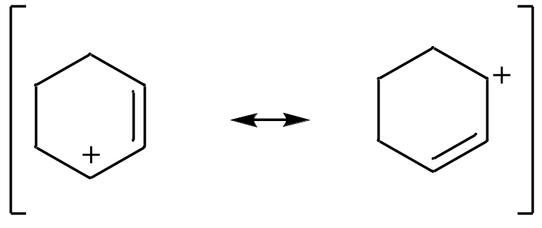
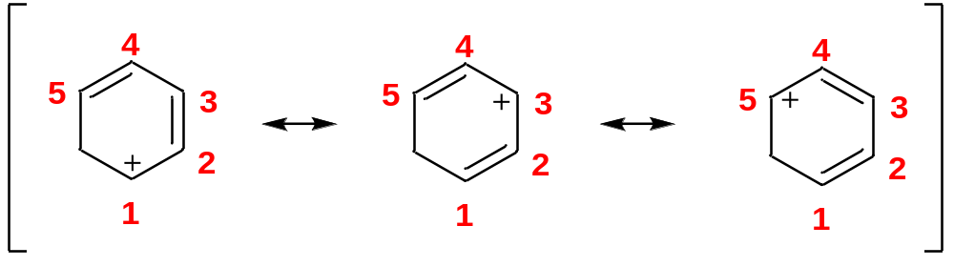
5-4-2 Allyllic cations
Allylic cations are more-substituted analogues of the allyl cation.
All allylic cations are stabilized by resonance with the adjacent double bond(s), which delocalizes the positive charge over two or more carbon atoms.
the major resonance form
the major resonance form

Slide 8
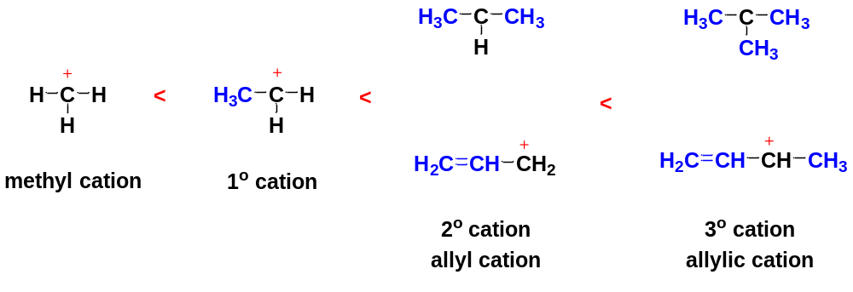
Allylic cations generally are about as stable as or more stable than simple 3° alkyl carbocations.
Stability of carbocations

Slide 9
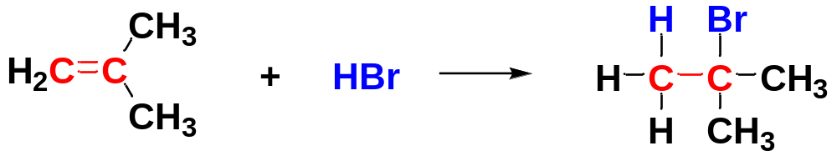
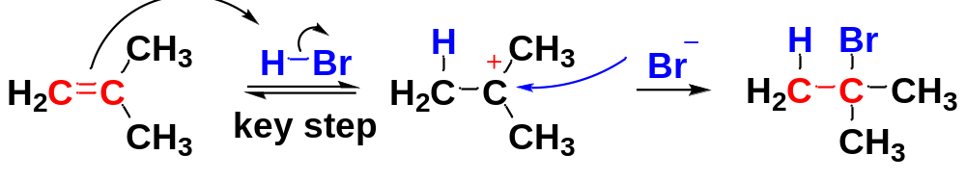
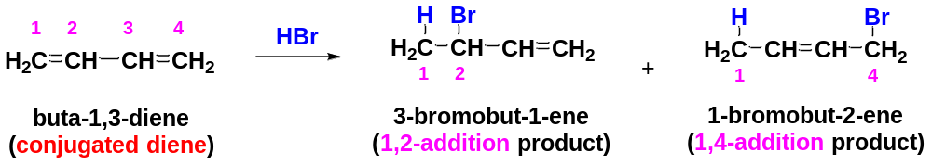
5-5 1,2- and 1,4-Addition to Conjugated Dienes
Electrophilic addition of HX to an alkene involves the formation of a carbocation.
Markovnikov product
Electrophilic additions to conjugated dienes usually involve allylic cations as intermediates, giving two products.

Slide 10
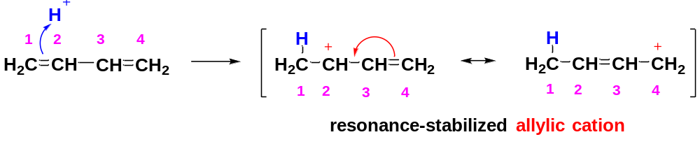
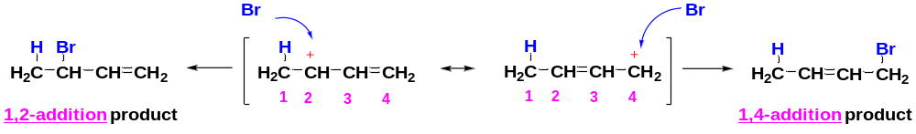
Mechanism
Step 1. Protonation of one of the double bonds forms a resonance-stabilized allylic cation.
In the allylic cation, the positive charge is delocalized (spread) over two carbons (C2 and C4). Therefore, each of these two carbons possesses a partial positive charge and is electrophilic.
Step 2. A nucleophile (Br⁻) attacks at either electrophilic carbon atom to form the 1,2- and 1,4-addition products.
The ratio of the 1,2- versus 1,4-addition can be controlled by changing reaction temperature.

Slide 11
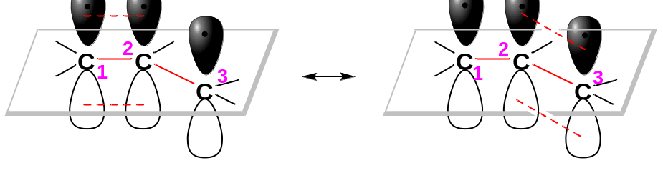
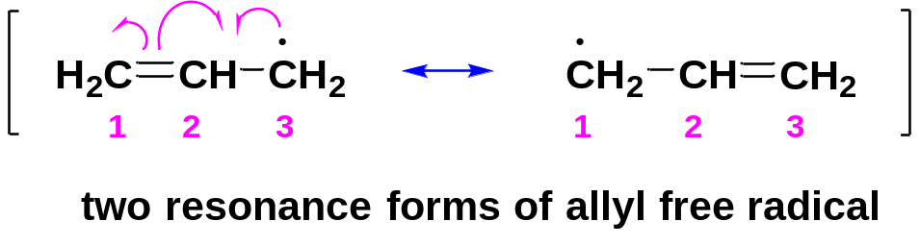
5-6 Allylic Radicals
5-6-1 Structure
The allyl cation has its positive charge delocalized over two carbon atoms, each possessing a partial positive charge.
Like allylic cations, allylic radicals are stabilized by resonance delocalization.
Both C1 and C3 have free radical character

Slide 12
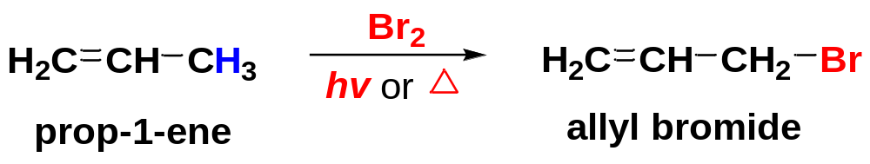
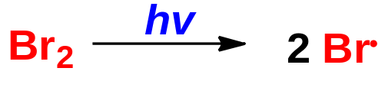
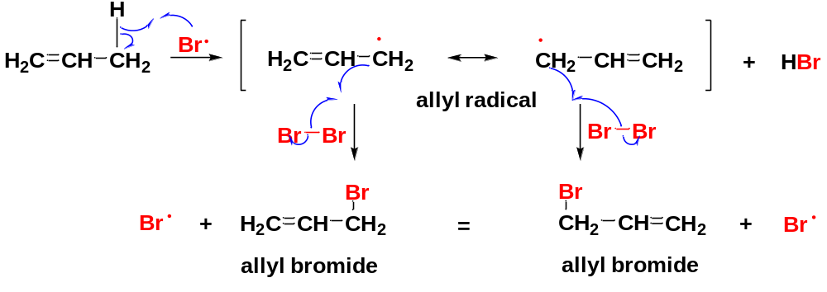
5-6-2 Free-Radical Allylic Bromination
In a free-radical bromination of prop-1-ene, substitution occurs entirely at the allylic position, producing allyl bromide.
Free-radical allylic bromination involves the formation and reaction of allylic radicals.
Mechanism
Step 1: Initiation: Formation of bromine radicals.
Step 2: Propagation: (1) the bromine radical abstracts an allylic hydrogen to produce an allylic radical; (2) the allylic radical in turn reacts with a bromine molecule to form an allyl bromide and a new bromine atom, which continues the chain reaction.
Abstraction of the allylic hydrogen is preferred because the resultant allylic free radical is resonance-stabilized (formed fast)

Slide 13
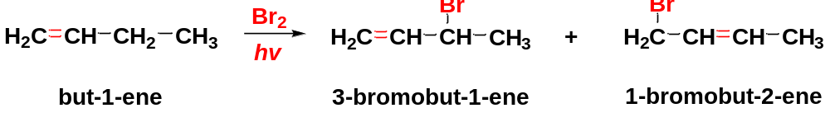
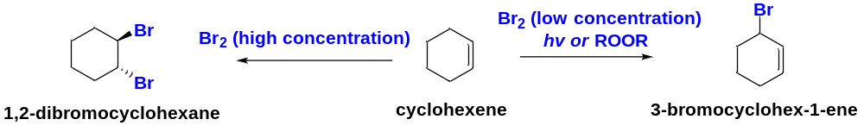
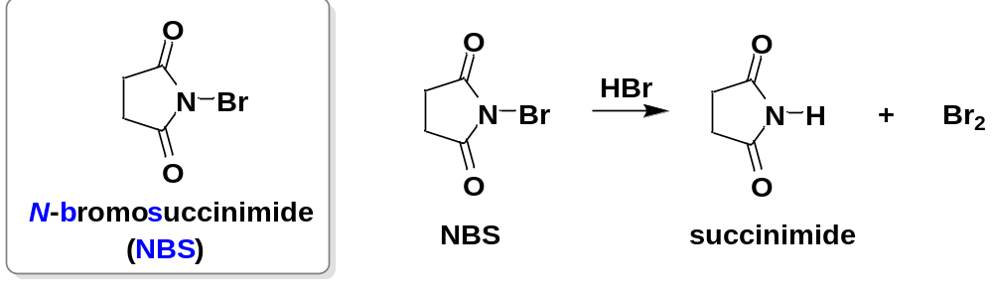
The key to getting substitution is to have a low concentration of bromine, together with light or free radicals to initiate the reaction. At higher concentrations, bromine adds across double bonds via a bromonium ion to give electrophilic addition products.
A convenient bromine source for allylic bromination is N-bromosuccinimide (NBS), because NBS provides a fairly constant, low concentration of bromine, which favors the free-radical substitution.
Electrophilic addition product
Free-radical substitution product

Slide 14
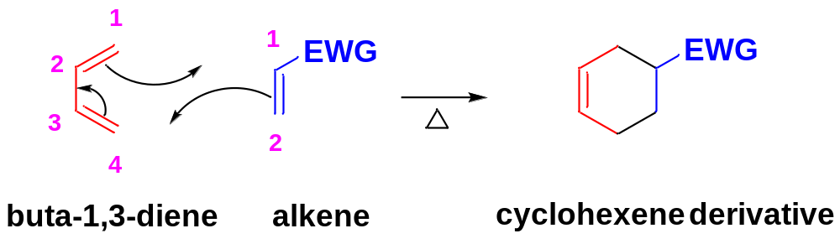
5-7 The Diels-Alder Reaction
German chemists Otto Diels and Kurt Alder discovered that alkynes and alkenes with electron-withdrawing groups add to conjugated dienes to form six-membered rings.
The Conjugated Diene is electron-rich. The presence of electron-donating groups (EDG) such as R or OR may further enhance the reactivity of the conjugated diene.
The Alkene containing electron-withdrawing groups (EWG) such as carbonyl (C=O) or cyano (CN) is electron-deficient. It’s also called a dienophile.
The D-A reaction is a [4 + 2] concerted cycloaddition.
3 π bonds break with 1 π bond and 2 σ bonds forming simultaneously to give a cyclohexene ring.

Slide 15
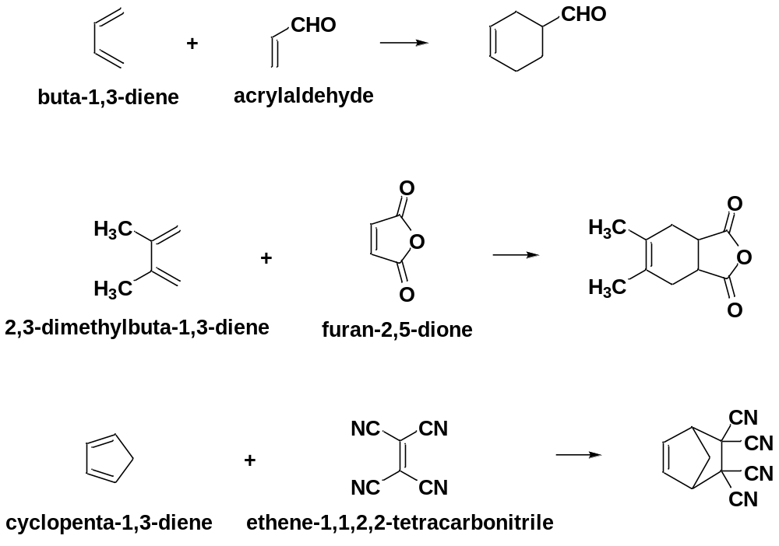

Slide 16
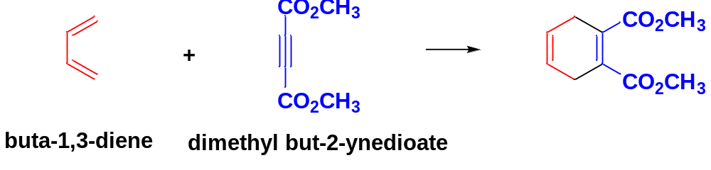
A diene reacts with an electron-deficient alkene to give a cyclohexene. A diene reacts with an electron-deficient alkyne to give a cyclohexadiene.
Synthetic significance of Diels-Alder Reaction: a useful synthetic tool, providing one of the best ways to make six-membered rings with diverse functionality and controlled stereochemistry.

